Slide 1

A New Successful Economic, Industrial, Financial, Territorial Management Model
SDGs and Circular Economy
Bologna, 18 July 2018

Slide 2
WHAT is it?
A joint initiative of the European Commission and the European Economic and Social Committee
Providing a European instrument where stakeholders can exchange across countries and across sectors
A « network of networks »
Support the transition and the EU Circular Economy Action Plan

Slide 3
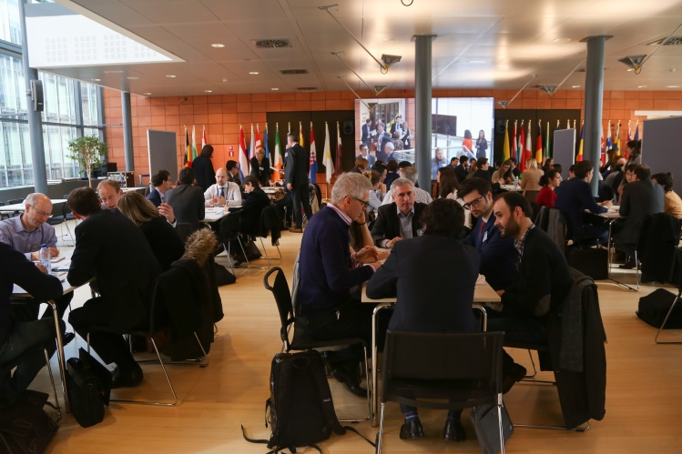
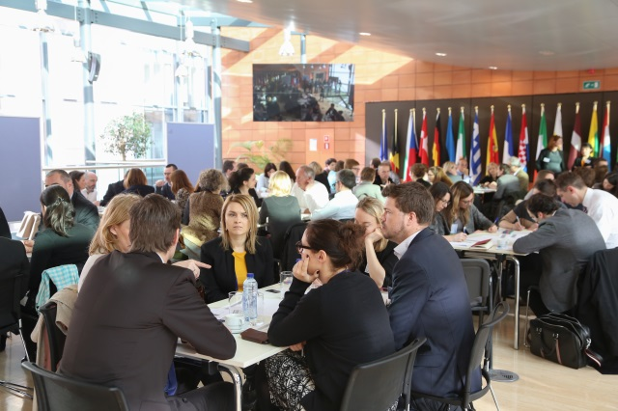
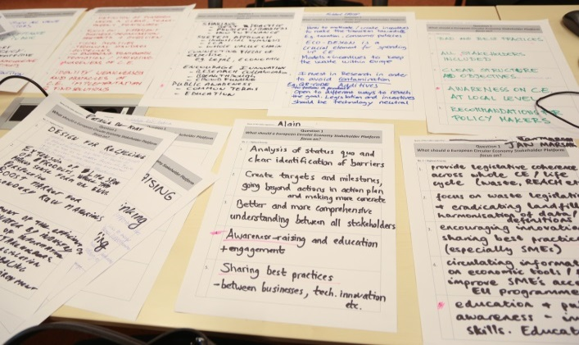
WHEN did it start?
Joint Circular Economy Stakeholder Conference organised by the European Commission and the European Economic and Social Committee in March 2017 (18-member delegation)

Slide 4
WHAT is it for?
Advancing the circular economy concept on the ground in Member States, regional and local governments, civil society and businesses
Strengthening the cooperation among stakeholders' networks to facilitate the exchange of expertise and good practices on the circular economy
Contribute to identify social, economic and cultural barriers to the transition towards a circular economy intended for policy makers at all level of governance

Slide 5
WHO is it for?
Stakeholders from all sectors and size already engaged in the transition towards circularity or willing to join the movement
namely:
Businesses, civil society organisations, trade unions
Multi-stakeholder organisations focusing on the circular economy
Local governments
The knowledge community

Slide 6
HOW does it work?
An online platform: https://circulareconomy.europa.eu/platform/en
  Information on Good Practices available online
  Further information under Knowledge, Strategy and Commitments tabs
  Map search feature to show what is happening and where
A Coordination Group composed of representatives of civil society and local governments networks
  Contact Information Directory for the Coordination Group Members details under Dialogue tab of website
An annual conference gathering the circular economy community

Slide 7
Coordination Group
24 representatives of civil society and local governments networks selected among 192 applicants (call for expression of interest was launched in summer 2017)
Inaugural CG meeting on 22 November – outcome:
  Concrete ideas for “networking the networks” (e.g. hosting events in the MS and streamlining larger conferences)
  3 Working Groups on CG actions to amplify the CE in Europe (Exchange of Practices, Providing Knowledge, Fostering Dialogue)

Slide 8
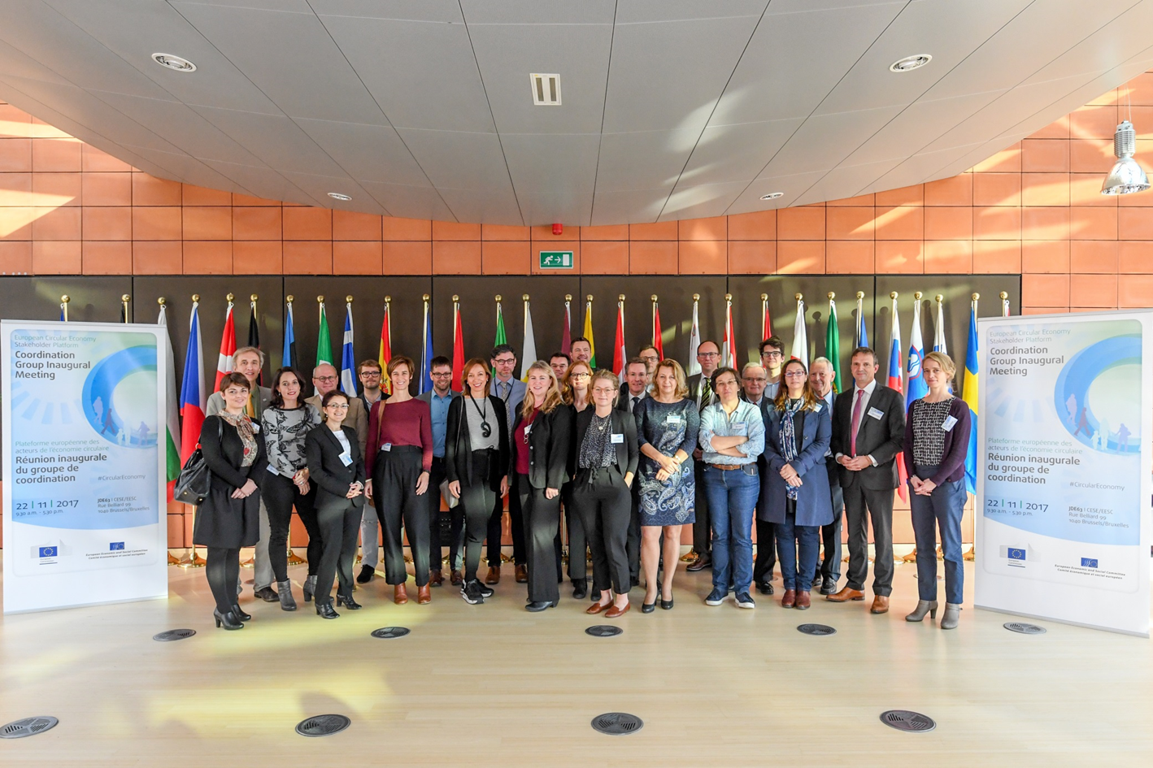
Coordination Group
Inaugural meeting - 22 November 2017

Slide 9
Website
A dedicated website/virtual platform: circulareconomy.europa.eu/platform
Launched on 10 November 2017
Phase-in approach to develop contents, enhance attractiveness and build up interactivity
Main focal point: good practices

Slide 10
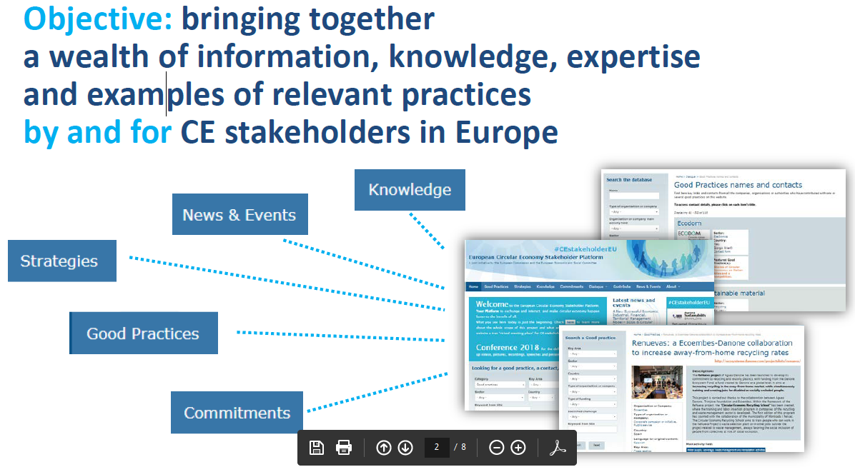

Slide 11
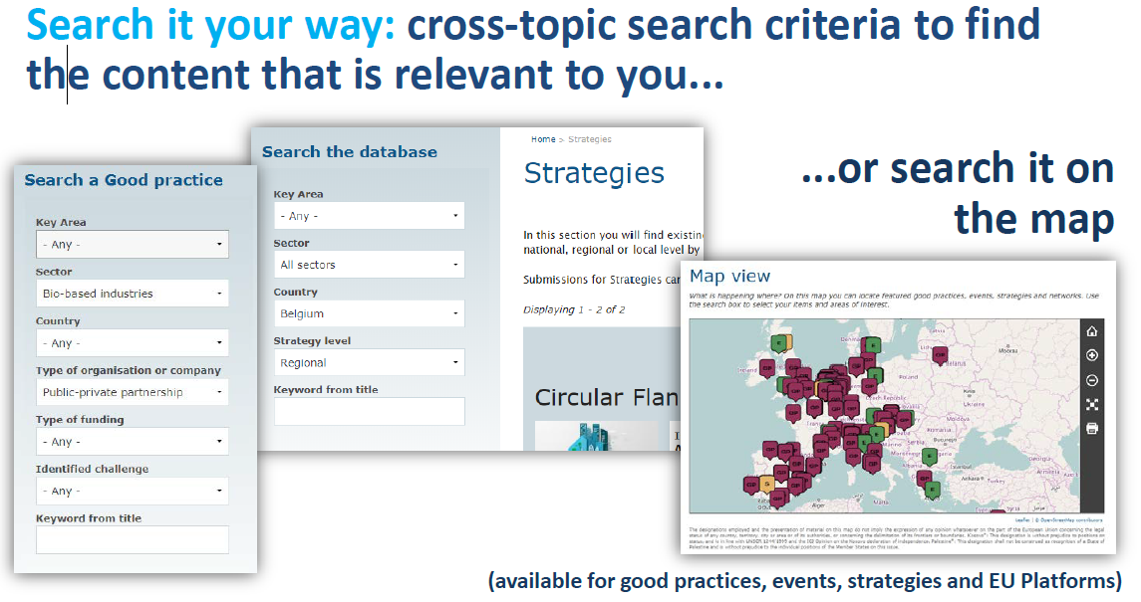

Slide 12
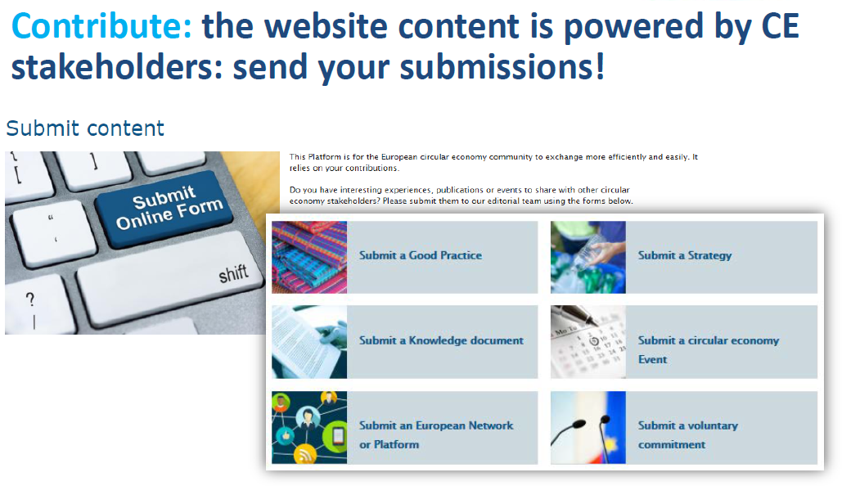

Slide 13
HOW to get involved?
Connect to circulareconomy.europa.eu/platform and share your experience and good practices
Contact the Platform at CEStakeholderEU@eesc.europa.eu and ask to be kept informed

Slide 14
Thank you for your attention!
CEStakeholderEU@eesc.europa.eu
Follow us on Twitter!
#CEStakeholderEU
@EESC_SDO @EESC_INT
@EU_ENV @EU_Growth

