Slide 1


Circular Economy dynamics: policies and innovations
H2020 Green.eu project “European Global Transition Network on Eco-Innovation, Green Economy and Sustainable Development”
Massimiliano Mazzanti

Slide 2
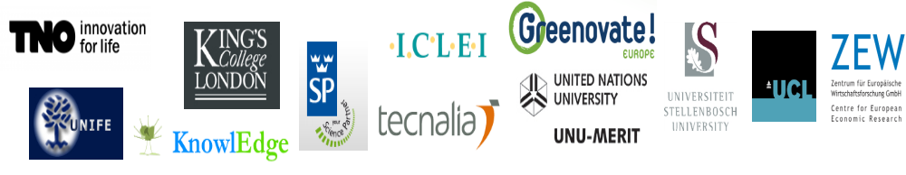
The h2020 Green.eu project

Slide 3
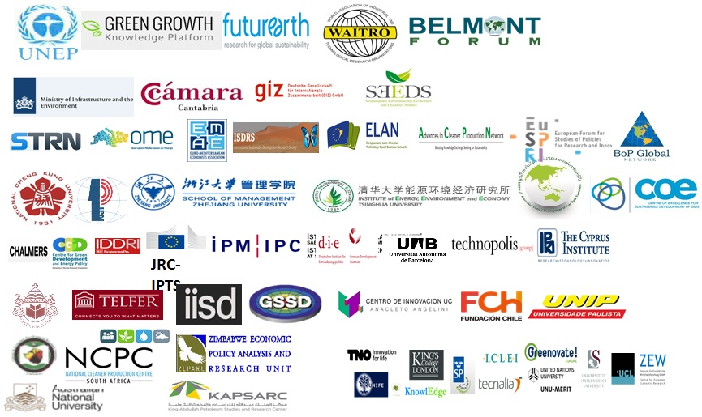
network of NetworkS*
(*) Infographic refers to entities/networks having expressed their interest to collaborate as of May 2017. Nether TNO nor inno4sd.net are by any means implying having obtained a formal endorsement or having acquired a trademark agreement for the use of the logos.

Slide 4
The circular economy: taking stock fromw aste and moving beyond and in a wider space

Slide 5
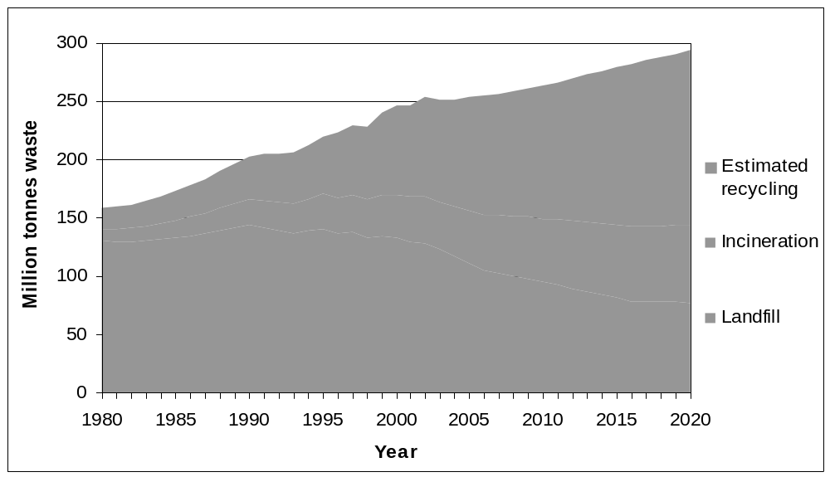
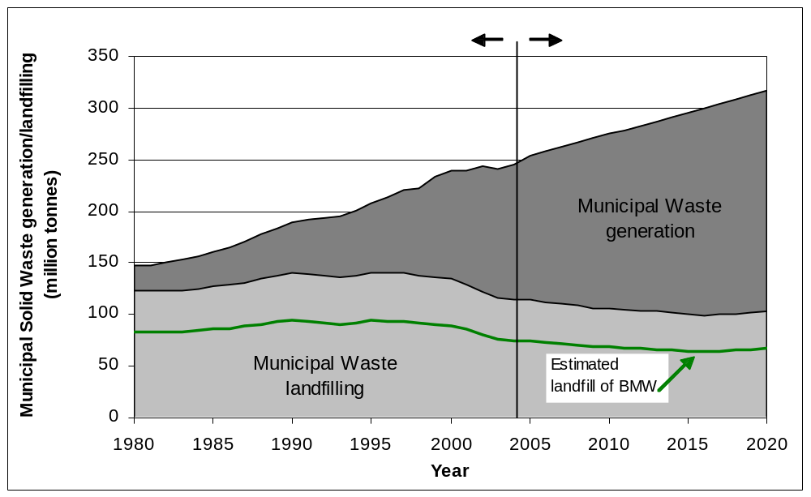
Scenarios: MSW generation and landfilling in the EU-27
Note: Figures from 1980-2004 are data from Eurostat.
Figures from 2005-2020 are projections. BMW = biodegradable municipal waste.
Source: EEA (2007).

Slide 6
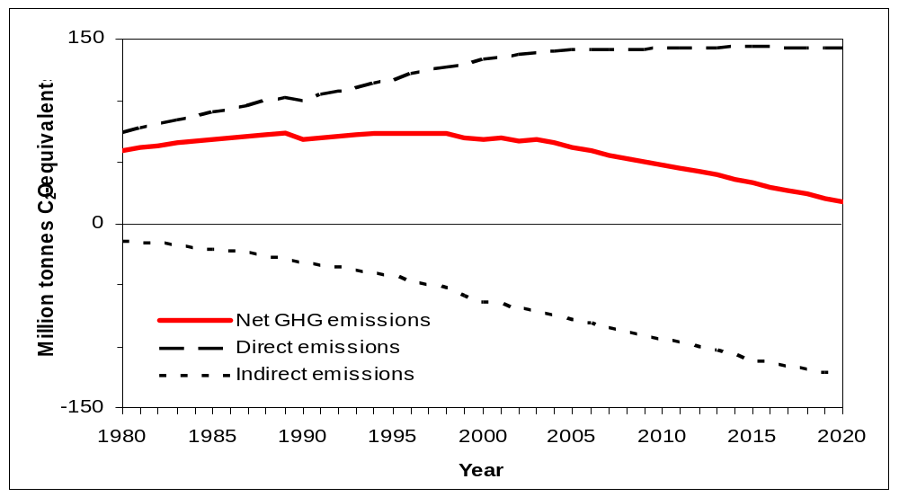
Waste: not less important, and related to climate change
→ → Moving away from landfilling
Notes:
Indirect emissions arise when waste is recycled into secondary materials and thereby replace the use of raw materials such as plastics, paper, metals etc., or when waste is incinerated with energy recovery and replace energy production from fossil fuels. The indirect emissions also include a minor contribution from landfills, namely the avoided CO2-emissions when methane is recovered in landfills and used as an energy source,

Slide 7
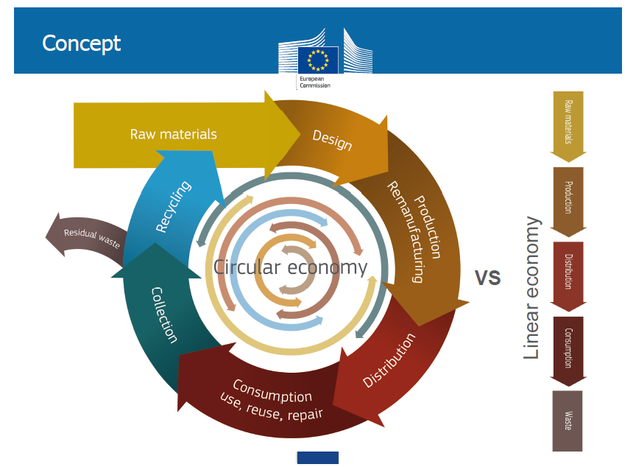
“The Circular economy offers an opportunity to reinvent our economy, making it more sustainable and competitive“
“This will bring benefits for European businesses, industries, and citizens alike”
(European Commission, December 2015)

Slide 8
The ‘CE package 2015’ is (largely) the latest development of EU waste policies
+
Revised legislative proposals on waste:
A common EU target for recycling 65% of municipal waste by 2030;
A common EU target for recycling 75% of packaging waste by 2030;
A binding landfill target to reduce landfill to maximum of 10% of municipal waste by 2030;
A ban on landfilling of separately collected waste;
Promotion of economic instruments to discourage landfilling;
Simplified and improved definitions and harmonised calculation methods for recycling rates throughout the EU;
Concrete measures to promote re-use and stimulate industrial symbiosis - turning one industry's by-product into another industry's raw material;
Economic incentives for producers to put greener products on the market and support recovery and recycling schemes (e.g. for packaging, batteries, electric and electronic equipments, vehicles).
EU Action Plan for the Circular Economy
Opening: “The transition to a more circular economy, where the value of products, materials and resources is maintained in the economy for as long as possible, and the generation of waste minimised, is an essential contribution to the EU's efforts to develop a sustainable, low carbon, resource efficient and competitive economy”

Slide 9
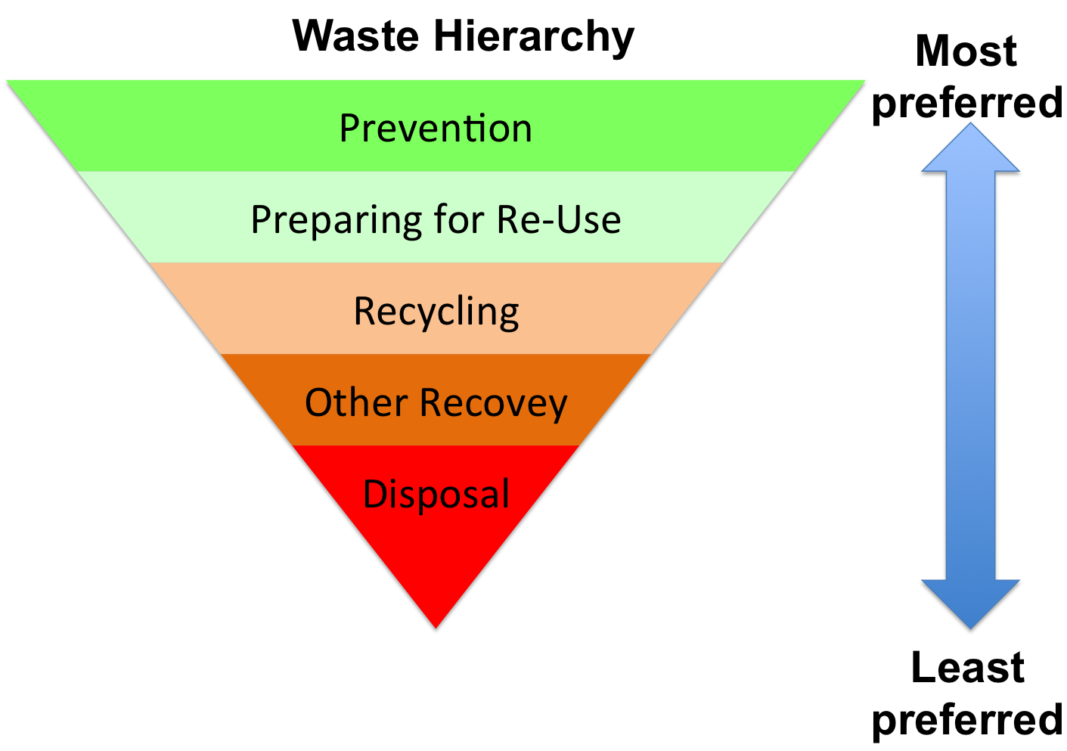

CE vision already in the EU ‘waste hierarchy’, 1970s
1975, Waste Framework Directive (1975/442/EEC) introduced the waste hierarchy (Art. 3)
The Ladder of Lansink
“The meaning of recycling is to save value” (Robert Ayres)

Slide 10
Waste management irreversibly away from landfill, and feeds the CE
Robust trend towards recycling/recovery of MSW (‘EU waste hierarchy’)
In 2012, MSW in landfill in EU27 were 62 million tons less than 1995
Estimated 500 million tons/year of materials in wastes waiting to be circulated back to the economic system
Actual and projected share of landfill, incineration, composting, and recycling for MSW in the EU27 (actual data 1996-2011, projections 2012-2030 - decimal % of total MSW treatment)
Projections
Source: EMInInn WP8

Slide 11
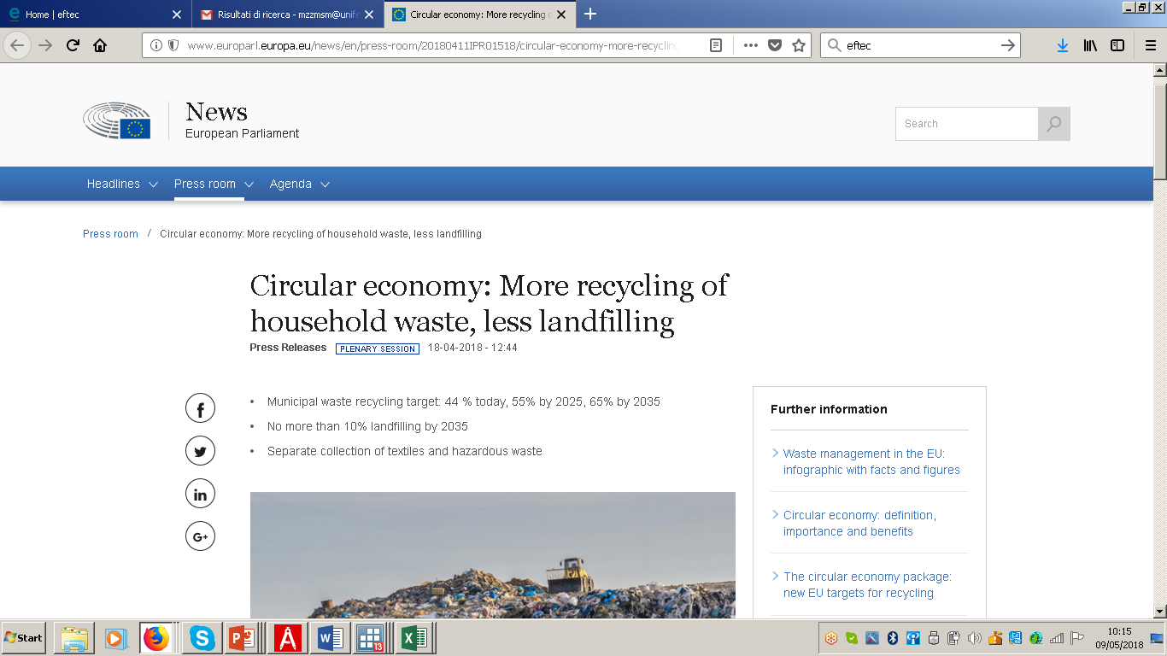

Slide 12
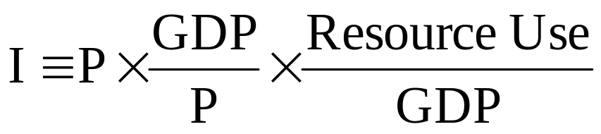
The IPAT identity
Measure impact in terms of mass
Use GDP for national income.
Then T is resource or waste per unit GDP.
Then for the resource extraction case, we have:
A T
Innovation and knowledge

Slide 13
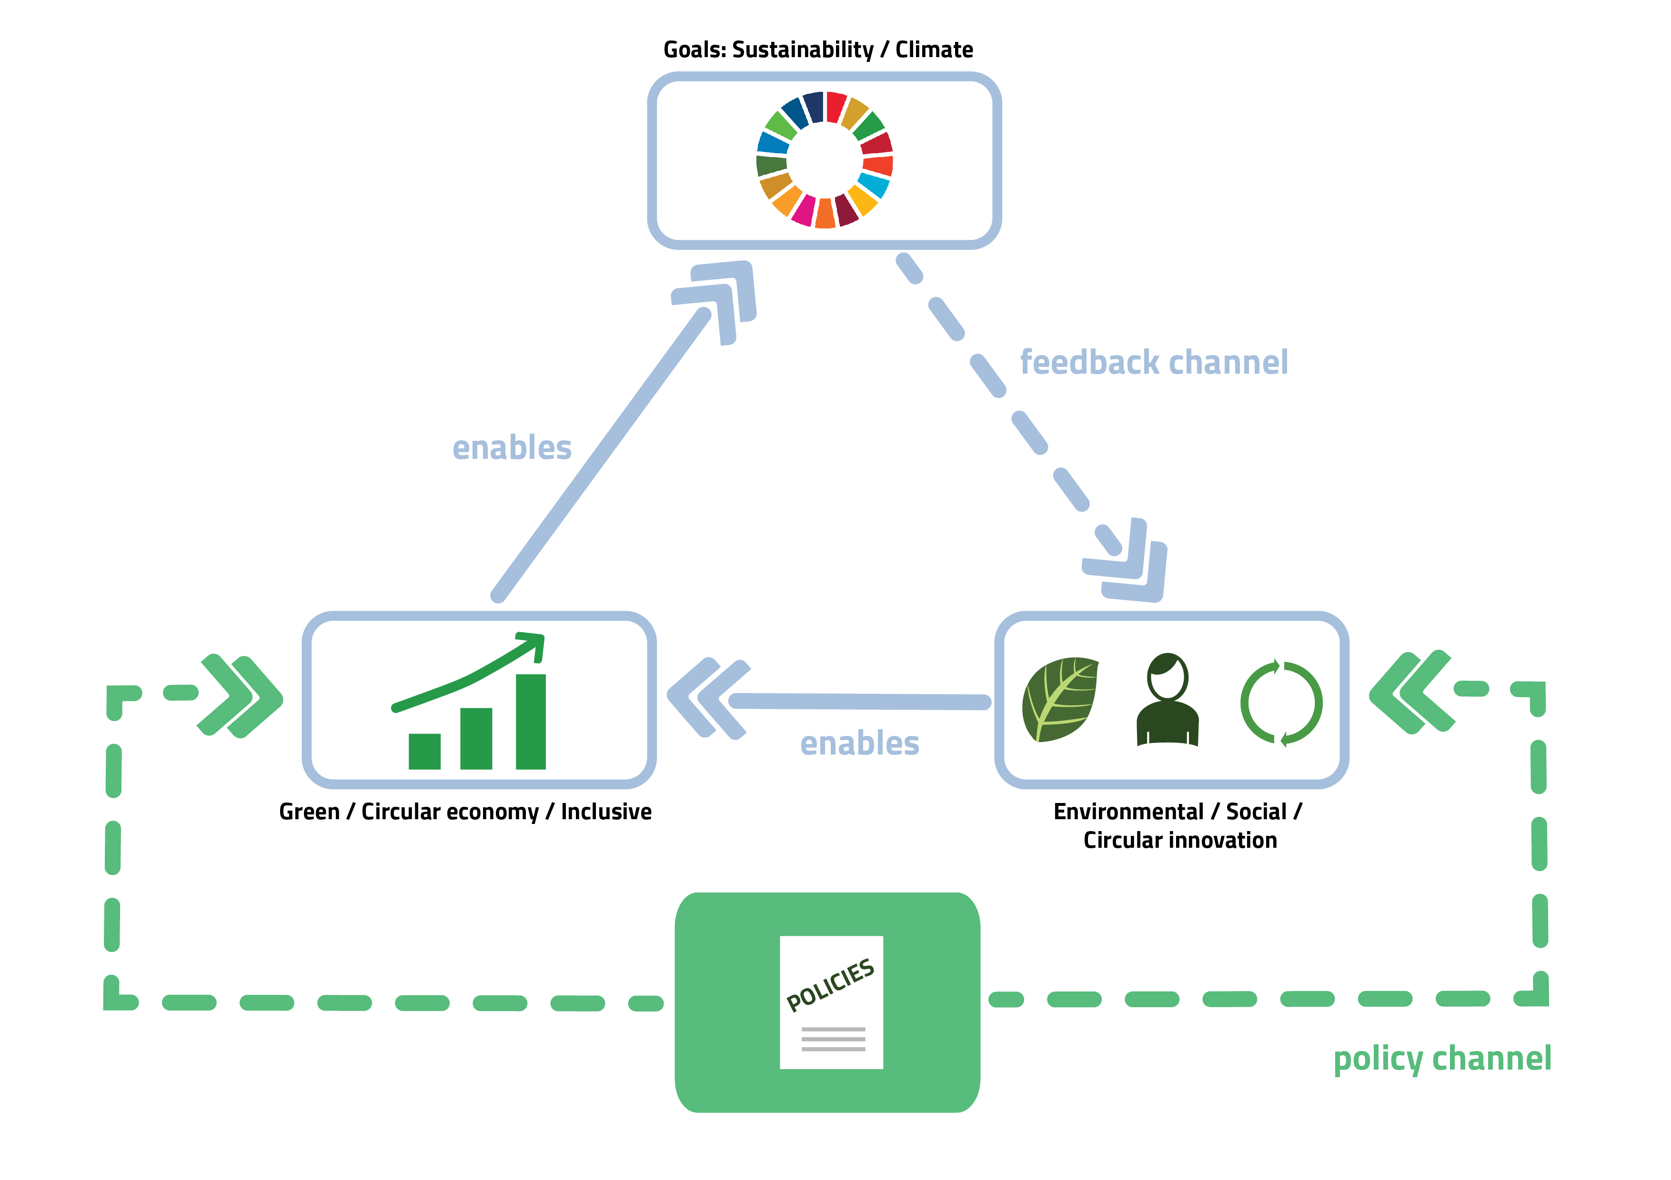
Innovation as an Enabler of Sustainable Economic Growth
Notes:
Feedback Channel: Eco-Innovation that enables a competitive sustainable economic development and thus a win-win situation itself increases the demand for such green innovations.
This channel accelerates the system and spurs sustainable development. Support by policy and high energy and resource prices and further accelerate this development.

Slide 14
The emerging issue is the role of knowledge and innovations

Slide 15

Innovation complementarities

Slide 16
Business case studies

Slide 17

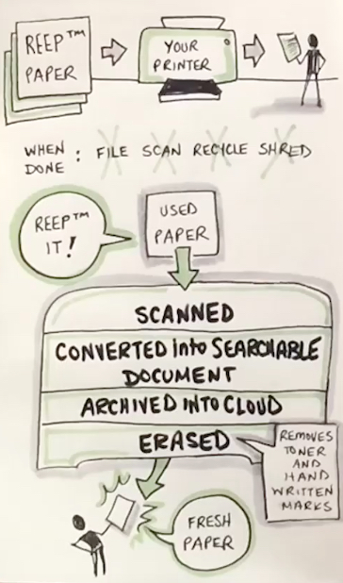
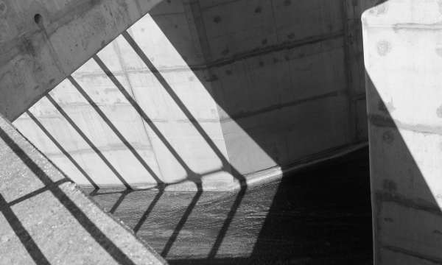
Fast fashion business model sostenibile
REEP tech ltd, Israeli start up
(scanner)

Slide 18
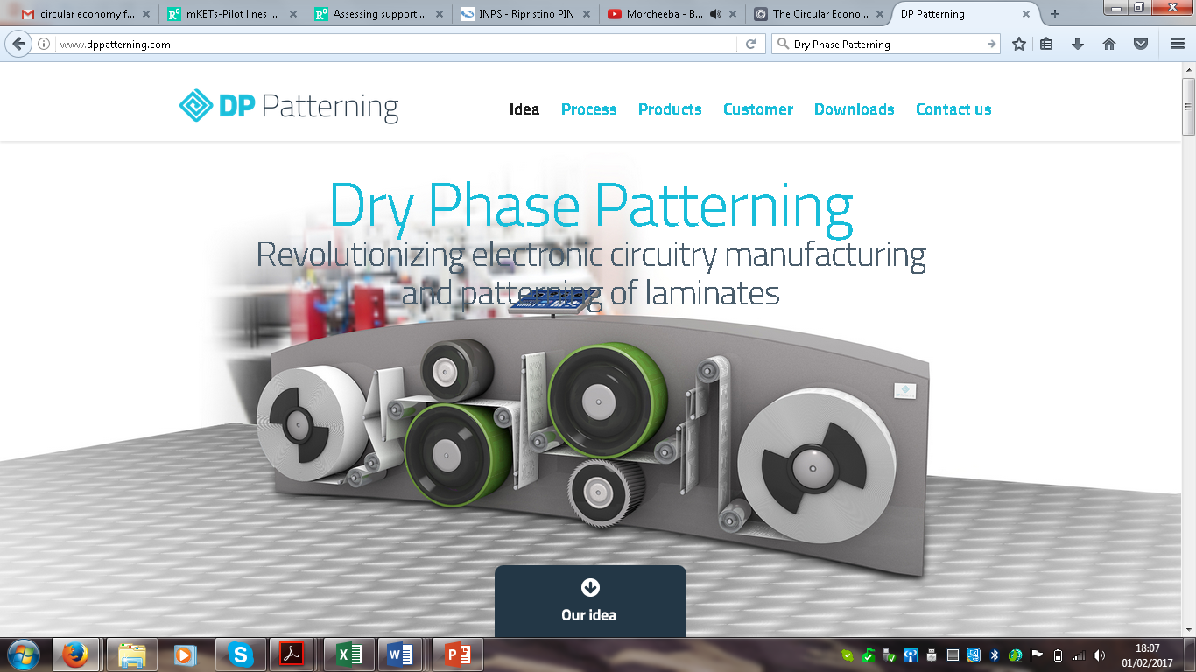
DPP (Dry fase Patterning)
(mechanical machining) vs chemical etching.
Micro-elettronica etc..)
http://www.dppatterning.com/

Slide 19
Steel
The Need – although steel as a material has inherent circularity, steel production still relies heavily on finite resources and produces a lot of waste and other externalities.
The Solutions – (1) using sustainably sourced charcoal as an alternative fuel source; (2) turn waste into valuable by-products.
What makes it circular? – cultivating fast-growing forest using polyculture principles, leads to carbon neutral steel, as well as regenerated natural capital.
The Benefits – 135,000 hectares of restored land and USD 45.8 million of revenue from by-products.
Steel is 'circular', but the industry is not
On one level, the steel industry is already very 'circular'. Steel, which has no significant degradation in quality after its first use, is already the most recycled material in the world, more than aluminium, paper, glass, gas and plastic combined.

Slide 20

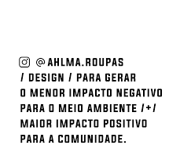
AHLMA circularity in a nutshell
80% materials from leftover fabric
Open source design
Lean inventory
Reusable shipping boxes
Instructions for extending life
Non-toxic cleaning
Repair lab for maintenance and remodelling
Subscription model available in concept store

Slide 21
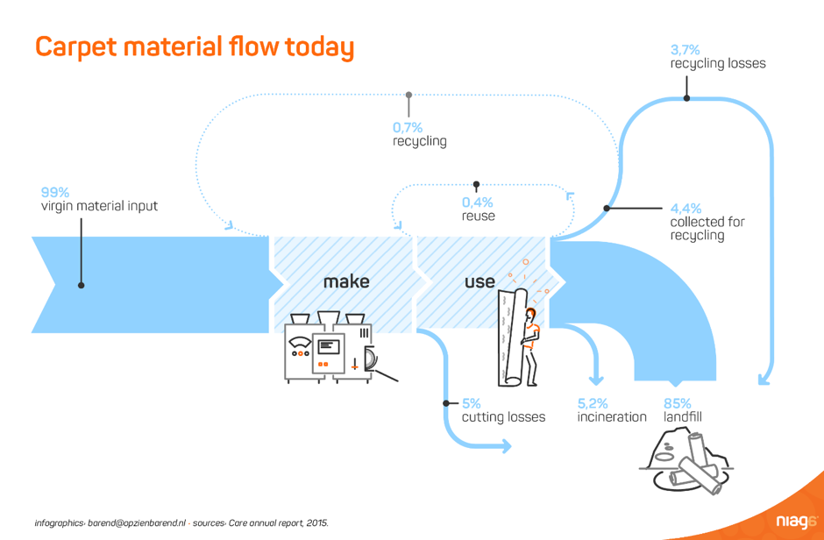
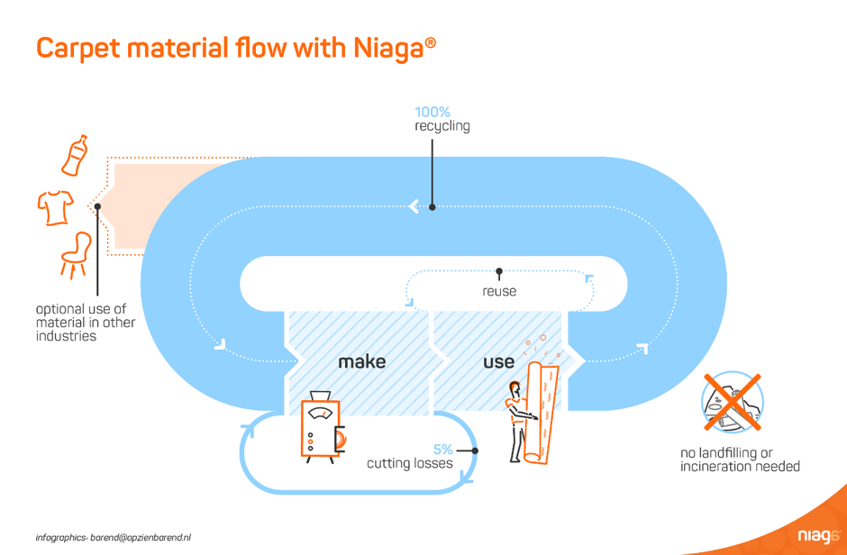
Background
For more than 60 years commercial carpeting has been made the same way. They are composed of a complex array of chemicals, including Latex and PVC, rendering the carpet materials unrecoverable at the end of the products use. The consequence is that a large amount of valuable material is lost, around 3.5 billion pounds of carpet end up in US landfills every year. The value of that material is about 5 billion dollars.
Technical Design and Innovation
Niaga (the word Again spelled backwards) has developed a carpet material which can be fully restored to its original form in an effective and economically viable way. At after-use-stage the carpets are collected and all materials can be recovered for input to a new carpet. The carpets are created out of either pure polyester or a dual combination of polyester and polyamide, polypropylene or wool. In this case, the two layers are married together with a reversible adhesive, in other words, they can easily be separated after use. The holistic design makes it possible to capture the material value after it has been used which in the subsequent usage phase enables a reduction in production cost.
Niaga® Technology, Niaga expects other companies to embrace
the move towards fully recyclable carpeting.
The Benefits
Reduces water and energy consumption in production
Reduces installation time by 25% (compared to traditional carpet)
Eliminates volatile organic compound (VOC) emissions
Lighter than traditional layer-bound carpeting
Improves indoor air quality

Slide 22


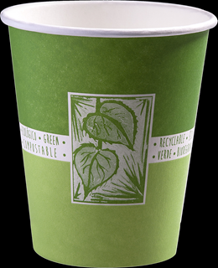

Slide 23
Macro EU setting

Slide 28
Hints and food for thought
The CE is a reality, driven by, and dependent on, (waste) policy
Major net benefits of a CE can be environmental, rather than economic
Beyond CE ‘business models’: up-scaling and diffusion
The CE is ‘inward looking’ and changes international trade

Slide 30
mission
The inno4sd network brings together networks, entities and individuals dedicated to innovation for sustainable development with the aim of reducing fragmentation and supporting collaboration, whilst engaging policy-makers, research & development, and businesses to achieve the sustainable development goals.

Slide 31
aims
The inno4sd network aims to advance the state-of-the-art in innovation for sustainable development by:
Reducing fragmentation by connecting multiple networks;
Supporting knowledge connectivity for collaboration and co-generation;
Engaging policy-makers, businesses, and researchers to enact change.
inno4sd aims to consolidate the global eco-innovation community and foster collaboration and knowledge sharing by bringing people together from all sectors related to the green economy, sustainability and innovation. It is an action-oriented network which will support the practical application of solutions to stimulate transformative change and support sustainable development, worldwide.

Slide 32
1. Reducing fragmentation by connecting multiple networks
inno4sd mobilises global actors to reduce fragmentation in the sustainability com-munity. By building a network-of-networks, inno4sd will avoid duplication of effort, harmonise definitions across different cultures, manage conflicting interests and trade-offs and increase a common awareness of how innovation can support sustainability. The network will increase the visibility of the work done by its members, and open opportunities for discussion and collaboration, worldwide.

Slide 33
2. Supporting knowledge connectivity for collaboration and co-generation
inno4sd is an open network which seeks to foster collaboration and knowledge sharing by bringing people together from all sectors related to sustainability and in-novation. Through symposia, networking events and webinars, inno4sd supports co-generation of knowledge, finding new ways to overcome barriers to sustainable development between policy-makers, academia, research and business.

Slide 34
3. Engaging policy-makers, businesses, and researchers to enact change
inno4sd is an action-oriented network which will support the practical application of solutions to stimulate transformative change. inno4sd provides access to policy reviews, guidelines and briefs on how to set policy frameworks for sustainability, pro-motes case studies on policy and business best practices, and provides practitioner-focused webinars, trainings and services. inno4sd engages actors worldwide through an online knowledge platform, which includes a networking and discussion tool for sustainability practitioners.

Slide 35
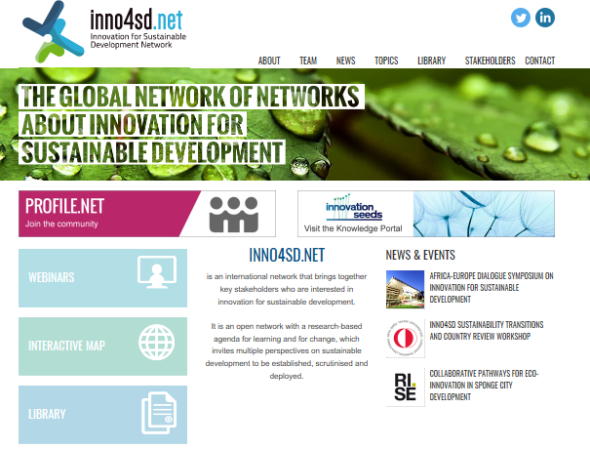
inno4sd.net® website

Slide 36
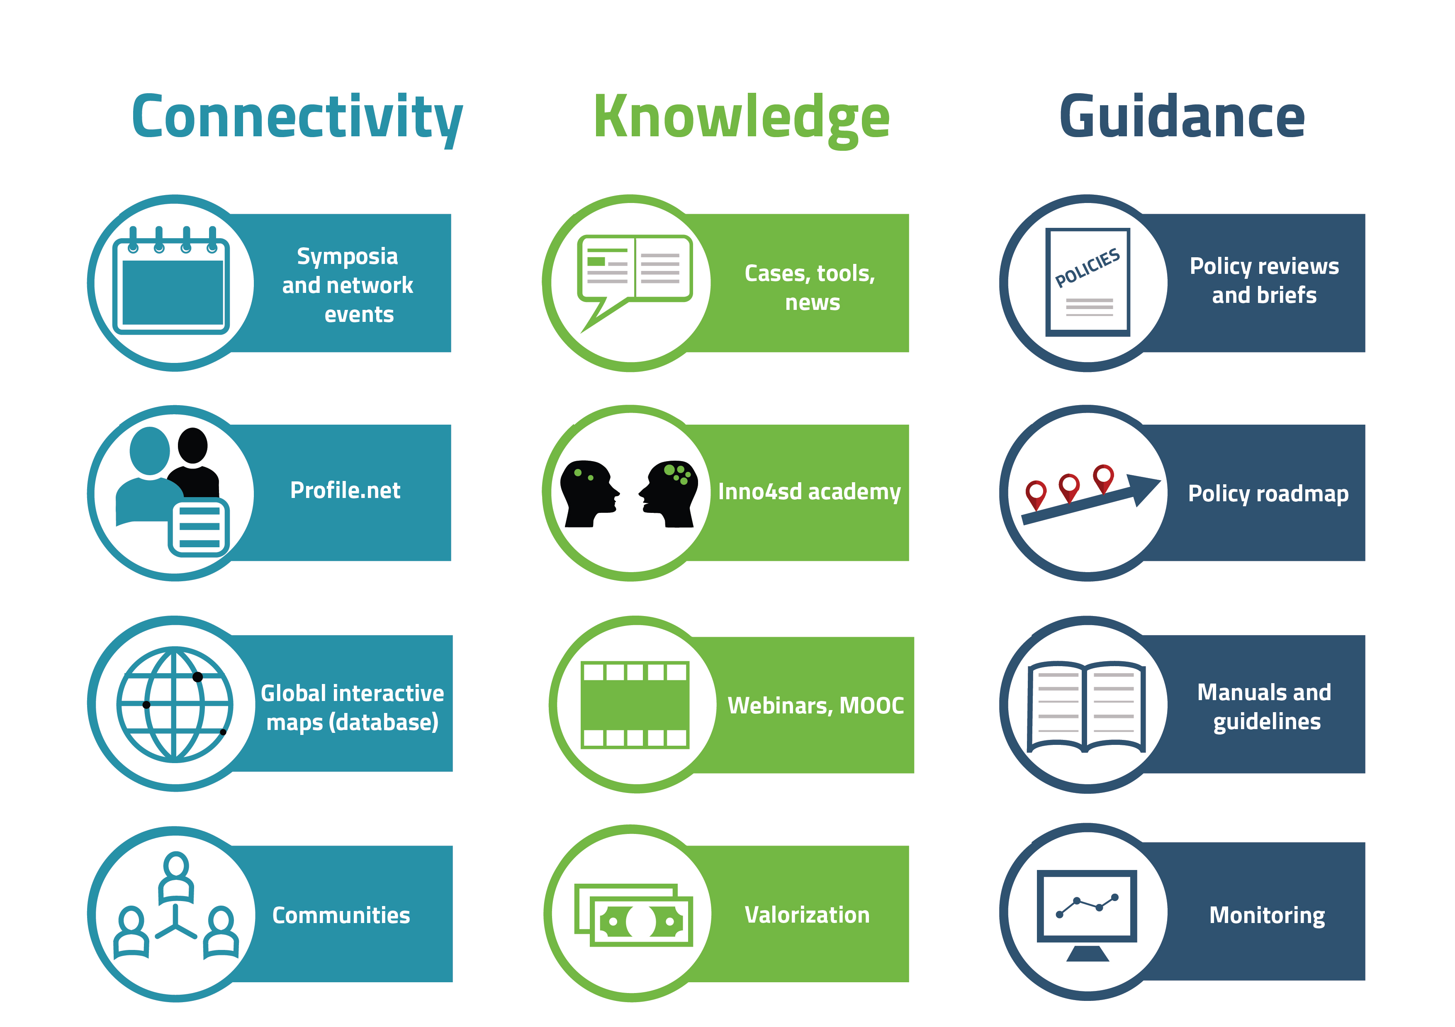
inno4sd.net® services

Slide 37
Who is who?
H2020 Green.eu project partners
inno4sd Network*
  Networks (academic, scientific, research, policy, industry)
  Multilateral – supra-national organisations (UN, Belmont Forum, etc.)
  Government agencies (National, regional, local levels)
  Stakeholders across the globe (Universities, Consultancy firms, SMEs, MNCs, NGOs, etc.)
  Individuals

Slide 38
The h2020 Green.eu project TEAM
13 partners – leading organisations in innovation for sustainable development
Research and Technology Organisations (TNO, TECNALIA, SP/RISE)
Universities (UCL, KCL, UNIFE, US)
Research Centres (ZEW, UNU-MERIT)
Specialised firms (GE!, KE)
Network organisations (ICLEI)

Slide 39
The h2020 Green.eu project
Research and Technology Organisations:
Netherlands Organisation for Applied Scientific Research TNO (NL, coordinator)
TECNALIA Research & Innovation (ES)
Research Centres of Sweden RISE/SP (SE)

Slide 40
The h2020 Green.eu project
Research Centres
Centre for European Economic Research (DE)
United Nations University – UNU MERIT (NL)

Slide 41
The h2020 Green.eu project
Universities and Higher Education Institutions:
University College London – Institute for Sustainable Resources (UK)
Kings College London (UK)
University of Ferrara (IT)
Catholic University Milano (IT)
Stellenbosch University (ZA)

Slide 42
The h2020 Green.eu project
Specialised firms & network organisations
Grennovate! Europe (BE)
KnowlEdge (IT/CH)
ICLEI European Secretariat (DE)

Slide 43
network of NetworkS*
(*) Infographic refers to entities/networks having expressed their interest to collaborate as of May 2017. Nether TNO nor inno4sd.net are by any means implying having obtained a formal endorsement or having acquired a trademark agreement for the use of the logos.

Slide 44


Who can join?
Networks
Programme owners
Private, public, not-for-profit entities
Knowledge organisations
individuals

Slide 45
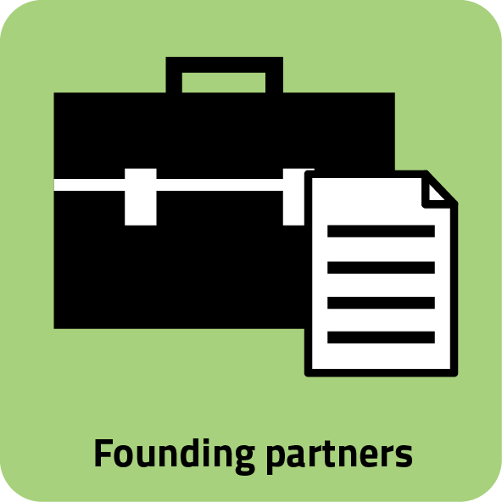
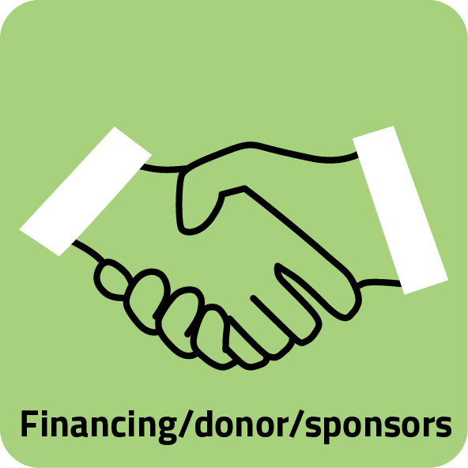

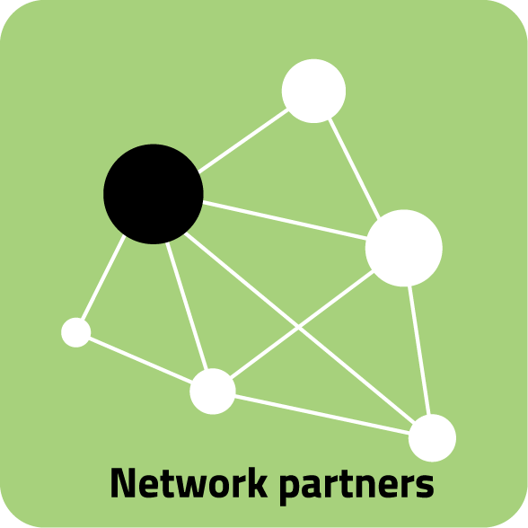


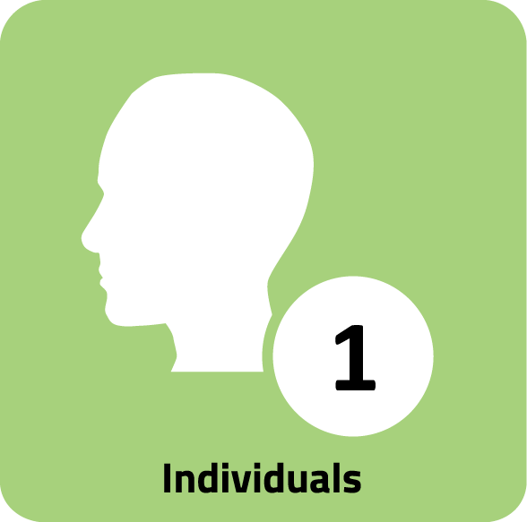

Types of members

Slide 46
How to join?
Simplified accession process until Dec. 2018; no membership fee.
It requires a formal adhesion – by means of a letter of intent
Benefits and obligations are currently under elaboration.
What you get:
Access to inno4sd.net® services
International visibility
Collaboration opportunities:
For country reviews, policy outlooks
Joint seminars, symposiums, workshops
Possibility to join the inno4sd academy®
Best practices, cases, research results
Policy guidelines and manuals

