Slide 1
The circular economy and climate – Making the pieces fit
Romain Pardo
July 18th, 2018

Slide 2
What is the circular economy? Why we need to close the loop?
Materials and products are re-used, recycled and repaired while the consumption of raw materials and waste generation is reduced.
Make processes more resource and energy efficient including through innovative business models.
Our current linear model, based on a ‘take, make, dispose approach’, is leading to the depletion of natural resources.
We need about 1.6 planets to provide the resources needed to maintain our production and consumption patterns. (By mid-2030s, 2 planets) (source: Living planet report 2016, WWF).
Material resource use could double between 2015 and 2050. Global use of materials will increase from 85 to 186 billion tonnes per year by 2050.
(According to the International Resource Panel)
Circular economy is essential to achieve SDG 12 and others, including SDG 13

Slide 3

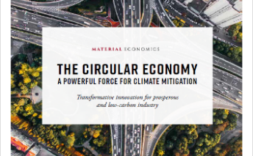
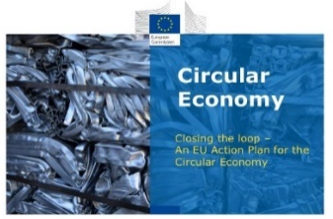
The role of circular economy in tackling climate change:
  Half of worldwide emissions could be linked to materials:
  2012 OECD study: materials management 54-64% of total GHG emissions (Australia, Mexico, Slovenia, Germany)
  Emission reduction potential:
“CO2 emissions from the mobility, food and built environment can decrease with 48% by 2030 and with 83% by 2050 compared to 2012 levels if these sectors become more circular. (measures including material efficiency, renewable energy and energy efficiency).”
“The transition towards a more circular economy can cut emissions from heavy industry by 56% by 2050.”
The European Commission recognises the potential of the circular economy to reduce CO2 emissions.

Slide 4
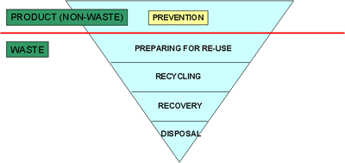
Follow the waste hierarchy:
→ The more the waste hierarchy is respected
the greater the potential of reducing emissions.
This approach was used by Delft university
(Publication: The circular economy as a key instrument for reducing climate change)
Source: European Commission Directive 2008/98/EC on waste (Waste Framework Directive)

Slide 5
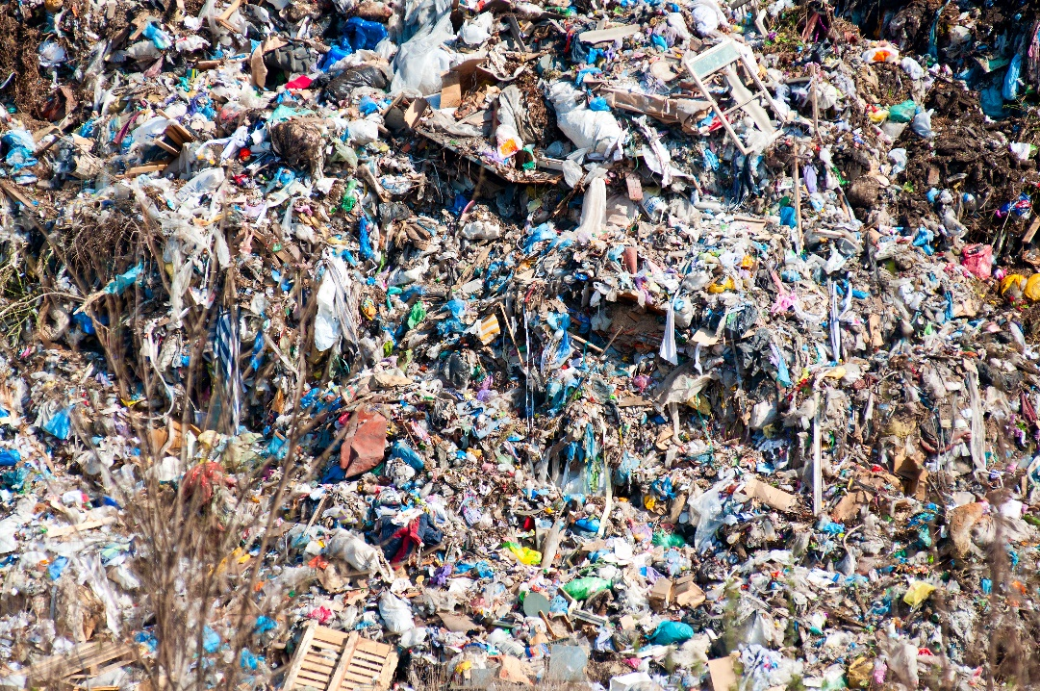
Landfilling:
According to the UNFCCC:
third largest source of anthropogenic methane (CH4) emissions
accounting for 11% of estimated global methane emissions in 2015.
Circular economy phasing out waste:
ideally achieving 0% landfilling
despite EU target of no more than 10% landfilling by 2035

Slide 6
Energy recovery or waste to energy
Reducing emissions from:
waste, including methane emissions
power plants and the extraction of fossil fuels with the production of energy through biowaste (eg: Suez wastewater treatment plant: produces biomethane from the sludge found in waste water)
BUT:
Burning solid waste, is a disincentive to respect the waste hierarchy and doesn’t reduce the demand in raw materials.

Slide 7

Recycling:
Enables to reduce demand in raw materials, demands less energy than production of primary materials:
  Circle economy and Ecofys (source: ‘Implemeting the circular economy globally makes Paris targets achievable)
    “Savings in energy use and greenhouse gas emissions by recycling will be between 40-80% for most materials compared to the energy needed to produce primary materials. (secondary or recycled aluminium demands only 5% of the energy that is needed to produce primary aluminium)”
EU recycling targets:
  All packaging: 70% by 2030
  Municipal waste: 65% by 2035

Slide 8
Reuse:
Reducing demand for primary raw materials by:
making products more durable or easier to repair from the design stage
or remanufacturing processes where a product or component is returned to a new like condition.
Extending the lifespan of a tablet and a laptop can reduce the CO2 emissions of these products by 21% and 19% respectively. (Source: “A circular economy for smart devices’ Green Alliance 2015.)
Examples/Initiatives:
predictive maintenance solutions.
Second hand markets, community initiatives, repair cafés, digital platforms for purchasing second hand products.
‘Ecodesign Working Plan 2016-2019’: In addition to making sure that more energy efficient products enter the market, the working plan aims to examine how eco-design could contribute to the transition towards a circular economy by making products more durable, easier to repair, reuse and recycle.

Slide 9
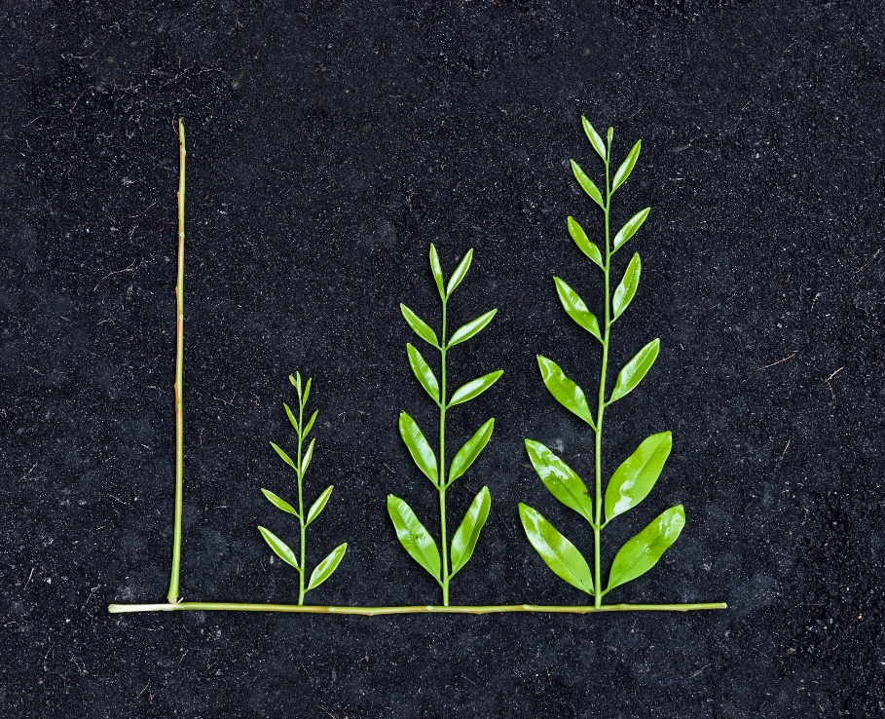
Reduce the demand of a product:
Rethinking the concept of ownership:
Use rather than ownership
Innovative business models: sell services rather than products.
(eg: Pay for electricity rather than lightbulbs ( Philips lighting))
Car sharing can contribute to reducing transport emissions

Slide 10
Making process more energy efficient:
Industrial symbiosis models:
Turning one industry's by-product into another industry's raw material but also energy.
Example in Ghent:
The residual heat of the Stora Enso paper company
    → provides the Ghent site of Volvo cars with hot water via a four kilometre-long heat network
    → allowing the Ghent plant to cut its annual CO₂ emissions by about 15,000 tonnes.

Slide 11
Challenges:
Silo approach:
Lack of awareness and risk of having parallel initiatives rather than creating synergies
Lack of references of the potential of circular economy to reduce emissions in EU or MS climate policies.
Risk of not identifying trade-offs: waste to energy, the use of biomass…
Barriers:
The transition towards the circular economy is not a reality yet
Behavioral barriers and the absence of a functioning market for secondary materials
Not a silver bullet:
CE not sufficient to fill in the gap of climate change mitigation
needs to be combined with other actions such as the deployment of renewables

Slide 12
Ideas for the way forward:
  The transition towards a decarbonised and circular economy in the same systemic shift:
  Integrate the circular economy in long term decarbonisation plans (including the Commission 2050 climate change strategy)
  Integrate the climate/circular economy synergies across different policies including industrial policies
  Consider the coherence between SDG related circular economy and climate goals in the EU’s and Member States SDG implementation strategies
  A shift that must happen at all levels: Global , European, regional and local level

Slide 13
Thank you for your attention !
rpardo@ieep.eu

