Slide 1


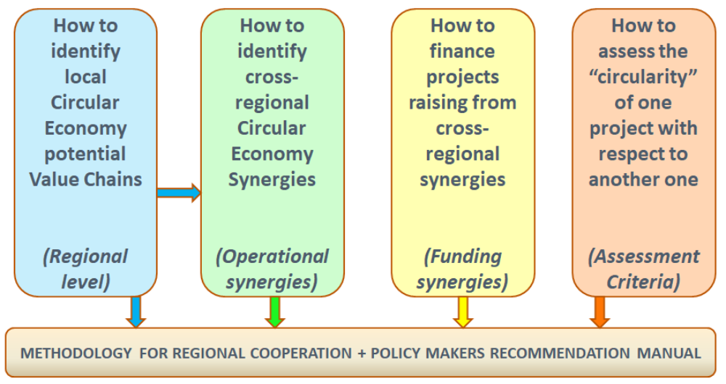
www.screen-lab.eu

