Slide 1
ENEA integrated approaches for resource efficiency
Value chain partnerships and commitments
Sala Guido Fanti – Regione Emilia Romagna
Bologna 18 Luglio 2018
Claudia Brunori
Divisione Uso efficiente delle risorse e chiusura dei cicli, Dipartimento Sostenibilità

Slide 2
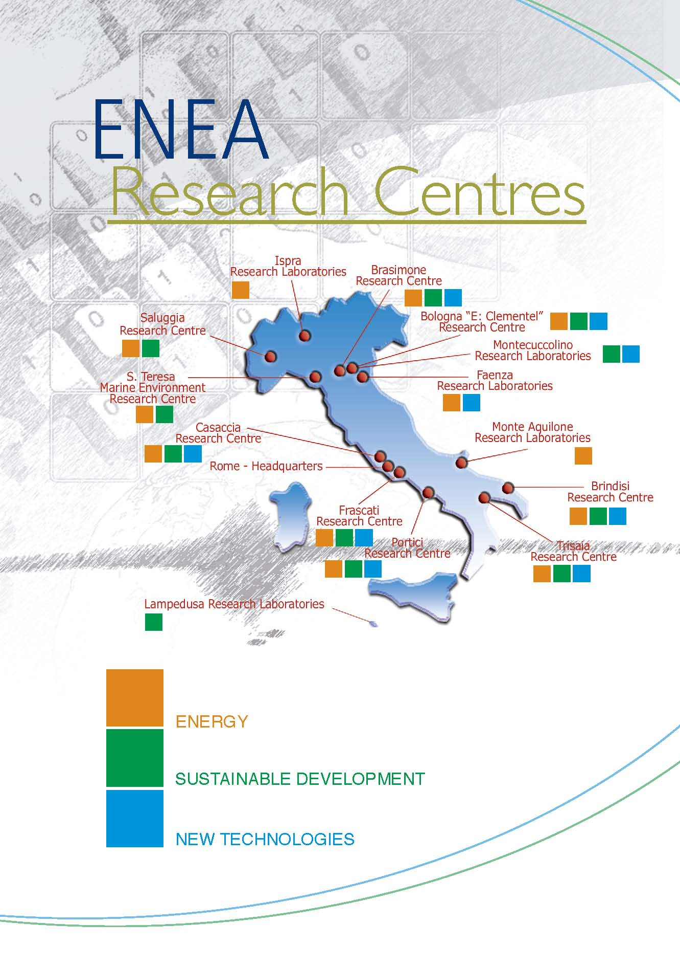
ENEA in figures
ENEA STAFF up to 30/06/2017:
2425 units

Slide 3
ENEA STRUCTURE
PRESIDENT
CENTRAL SECURITY UNIT
BOARD OF DIRECTORS
TECHNICAL SCIENTIFIC COMMITTEE
Department for Sustainability
SSPT
General Responsible of management
Department for Energy Efficiency
DUEE
Vice General Director
Department for Energy Technologies
DTE
Departments
Units/Institutes
Radiation protection institute
External relationships and communication unit
Studies and strategies unit
Antarctica technical unit
Department for Fusion and Nuclear Security Technologies
FUS

Slide 4
Department for sustainability
Structure
Servizio Gestione e Funzionamento (GEF)
Dipartimento Sostenibilità dei sistemi produttivi e territoriali (SSPT)
Sezione Supporto Tecnico Strategico (STS)
Sezione Supporto Coordinamento attività su Economia Circolare (SEC)
Servizio Acquisizione Beni e Servizi(ABS)
Sezione Trasferimento tecnologico verso i PVS in ambito cambiamento climaticio(PVS)
Div. Uso Efficiente delle risorse e chiusura dei cicli (USER)
Div. Tecnologie e processi dei materiali per la sostenibilità (PROMAS)
Div. Modelli e Tecnologie per la riduzione degli impatti antropici e dei rischi naturali (MET)
Div. Protezione e valorizzazione del territorio e del capitale naturale (PROTER)
Div. Biotecnologie e agroindustria (BIOAG)
Div. Tecnologie e metodologie per la salvaguardia della salute (TECS)
Lab. Valorizzazione delle risorse nei sistemi produttivi e territoriali (RISE)
Lab. Materiali e processi chimico-fisici (MATPRO)
Lab. Biodiversità e servizi ecosistemici (BES)
Lab. Biotecnologie (BIOTEC)
Lab. Tecnologie biomediche (TEB)
Lab. Modellistica climatica e impatti (CLIM)
Lab. Materiali funzionali e tecnologie per applicazioni sostenibili (MATAS)
Lab. Sostenibilità, qualità e sicurezza delle produzioni agroalimentari (SOQUAS)
Lab. Tecnologie per il riuso, riciclo, recupero e valorizzazione di rifiuti, e materiali (T4RM)
Lab.BioGeoChimica Ambientale (BIOGEOC)
Lab. Inquinamento atmosferico (INAT)
Lab. Biosicurezza e stima del rischio (BIORISC)
Lab. Tecnologie dei Materiali Faenza (TEMAF)
Lab. Tecnologie per l’uso e gestione efficiente di acqua e reflui (T4W)
Lab. Tecnologie per la dinamica delle strutture e la prevenzione del rischio sismico e idrogeologico (DISPREV)
Lab. Osservazione e analisi della terra e del clima (OAC)
Lab. Bioprodotti e bioprocessi (PROBIO)
Lab. Nanomateriali e dispositivi (NANO)

Slide 5
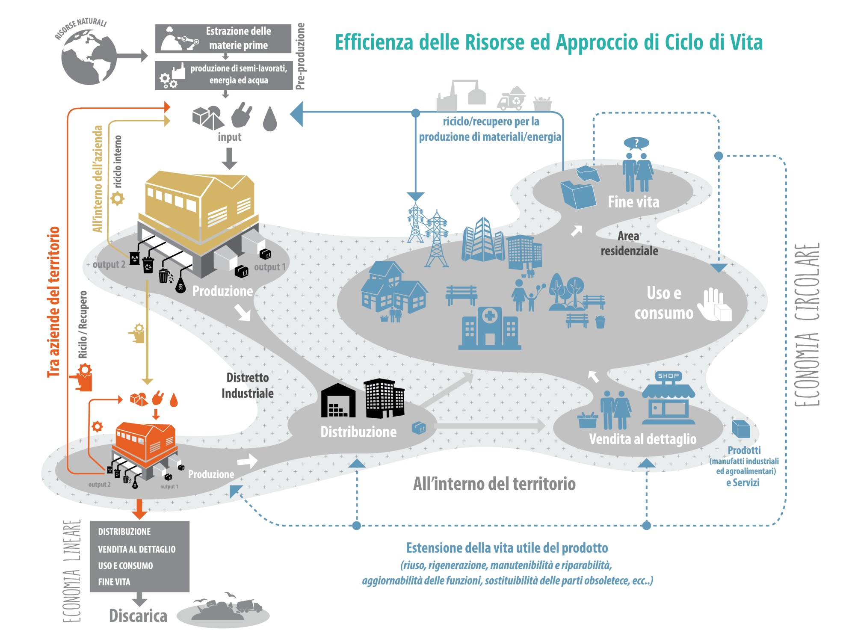
From linear economy to circular economy…
Multidisciplinar horizontal approach for Circular Economy

Slide 6
Department for sustainability
Structure
Dipartimento Sostenibilità dei sistemi produttivi e territoriali (SSPT)
Sezione Supporto Tecnico Strategico (STS)
Servizio Gestione e Funzionamento (GEF)
Support to the coordination of Circular Economy activities (SEC)
Sezione Supporto Coordinamento attività su Economia Circolare (SEC)
Servizio Acquisizione Beni e Servizi(ABS)
Sezione Trasferimento tecnologico verso i PVS in ambito cambiamento climaticio(PVS)
Multidisciplinar horizontal approach for Circular Economy
Div. Uso Efficiente delle risorse e chiusura dei cicli (USER)
Div. Tecnologie e processi dei materiali per la sostenibilità (PROMAS)
Div. Modelli e Tecnologie per la riduzione degli impatti antropici e dei rischi naturali (MET)
Div. Protezione e valorizzazione del territorio e del capitale naturale (PROTER)
Div. Biotecnologie e agroindustria (BIOAG)
Div. Tecnologie e metodologie per la salvaguardia della salute (TECS)
Division for Resource Efficiency (USER)
Lab. Valorizzazione delle risorse nei sistemi produttivi e territoriali (RISE)
Lab. Materiali e processi chimico-fisici (MATPRO)
Lab. Biodiversità e servizi ecosistemici (BES)
Lab. Biotecnologie (BIOTEC)
Lab. Tecnologie biomediche (TEB)
Lab. Modellistica climatica e impatti (CLIM)
Lab. Materiali funzionali e tecnologie per applicazioni sostenibili (MATAS)
Lab. Sostenibilità, qualità e sicurezza delle produzioni agroalimentari (SOQUAS)
Lab. Tecnologie per il riuso, riciclo, recupero e valorizzazione di rifiuti, e materiali (T4RM)
Lab.BioGeoChimica Ambientale (BIOGEOC)
Lab. Inquinamento atmosferico (INAT)
Lab. Biosicurezza e stima del rischio (BIORISC)
Lab. Tecnologie dei Materiali Faenza (TEMAF)
Lab. Tecnologie per l’uso e gestione efficiente di acqua e reflui (T4W)
Lab. Tecnologie per la dinamica delle strutture e la prevenzione del rischio sismico e idrogeologico (DISPREV)
Lab. Osservazione e analisi della terra e del clima (OAC)
Lab. Bioprodotti e bioprocessi (PROBIO)
Lab. Nanomateriali e dispositivi (NANO)

Slide 7
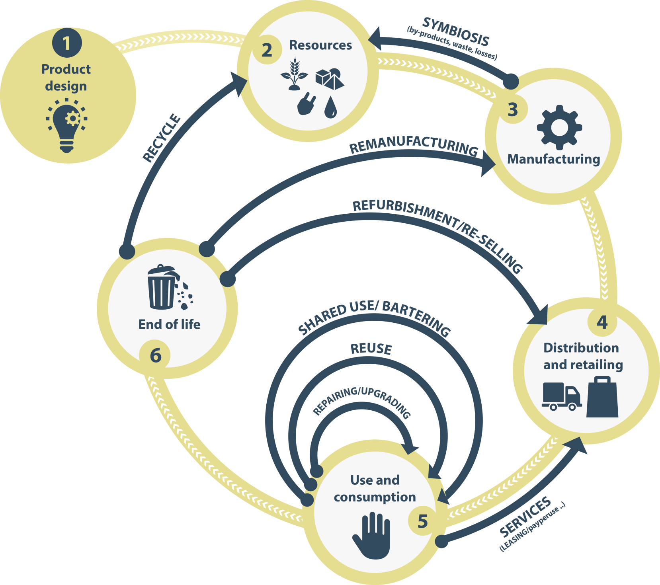
ENEA for circular economy
Product Eco-Innovation
Eco-design
Life Cycle Thinking (LCT, LCA,..)
Recyclability, durability, easy disassembly
Raw Materials: nanomaterials, biomaterial, recycled materials, critical and hazardous raw materials substitution
Process Eco-Innovation
Low resource consumption
Low energy consumption
Low emissions
Clean technologies
Lean technologies
System Eco-Innovation
Industrial symbiosis
Sharing economy (Remanufacturing, second hand products, from goods posses to services)
Waste management
Urban mining/landfill mining
Reuse/Remanufacture/Recycling

Slide 8
Industrial symbiosis
Industrial symbiosis is a strategy aiming at the efficient and optimal use of resources (materials, energy, water, expertise, etc.) among companies. Mutual benefits and competitive advantages arise for companies implementing industrial symbiosis
“…There are relationships between industries, sometimes simple, but often quite complex, which enter into and complicate the analysis. Chief among these is the phenomenon of industrial symbiosis. By this is meant the consorting together of two or more of dissimilar industries. …”.
Renner, Renner, G.T.. Geography of Industrial Localization. Economic Geography 23, no. 3: 167–189., 1947
“Industrial symbiosis engages traditionally separate industries and other organisations in a network to foster innovative strategies for more sustainable resource use (including materials, energy, water, assets, expertise, logistics etc.)..…..”
Lombardi & Laybourn, NISP
In Italy over 180 milion tons of waste/year are produced, 80% of these are not dangerous industrial waste

Slide 9
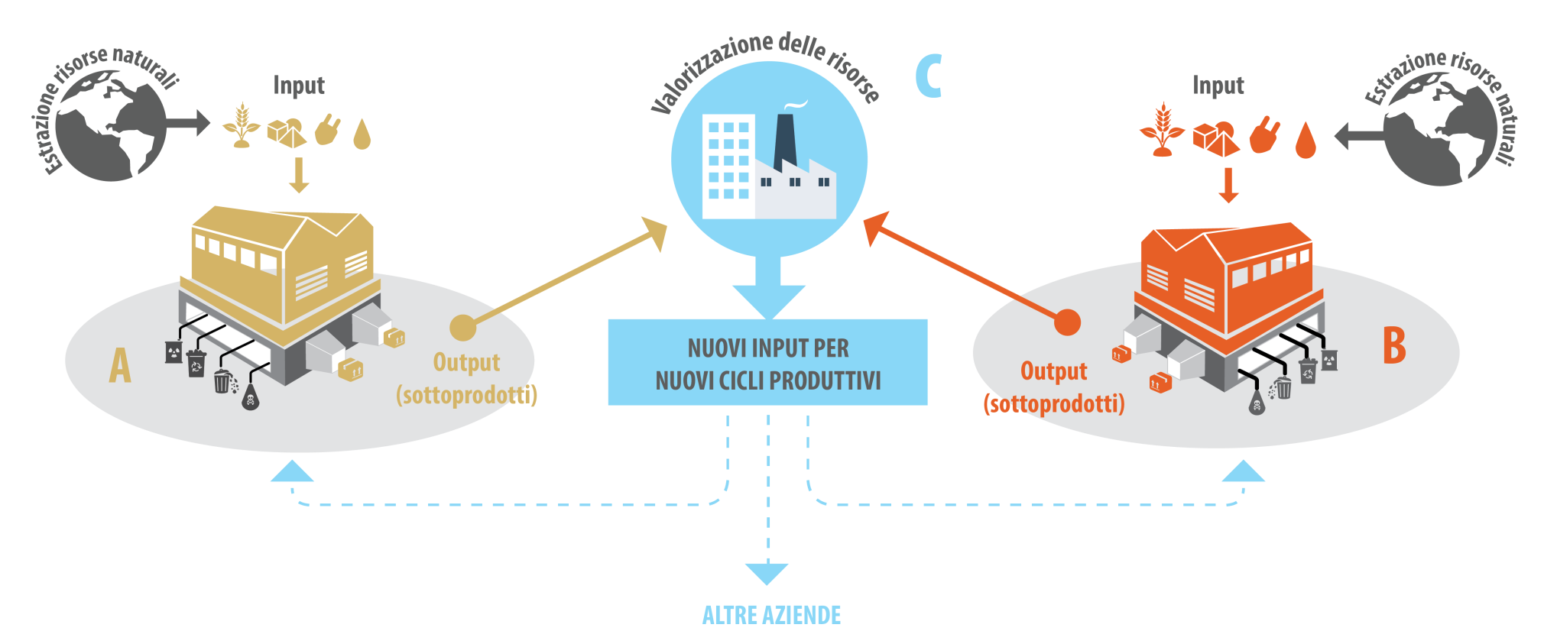
Industrial symbiosis
Economic benefits
Reduced costs for raw materials supply and for waste disposal and management
New business network
New market opportunities
Environmental benefits
Optimisation of resources use
Mitigation of environmental impacts and emissions
Reduction of the quantitiy of waste landiflled
Social benefits
Job (so called «green jobs»)
Cultural shift (sharing economy)

Slide 10

ENEA’s methodology for industrial symbiosis
The ENEA methodology is based on a «horizontal» approach (network), aiming at closing the loop creating sinergies for resource sharing
Language of symbiosis
Communication to companies
Knowledge and expertise
THE ENEA INDUSTRIAL SYMBIOSIS PLATFORM
Tool for companies and other operators to activate resource sharing (materials, energy, water, logistics, expertise)

Slide 11

ENEA projects on Industrial Symbiosis
Lazio – Area industriale di Rieti (ASI Rieti Cittàducale)
27 imprese partecipanti georeferenziate - circa 140 I/O - 110 sinergie potenziali
Emilia-Romagna – Progetto FOOD CROSSING DISTRICT
Progetto in corso finanziato dalla Regione ER updating piattaforma di simbiosi industriale, focus sinergie scarti specifici agroindustria
Ongoing Regional project in Food sector (FOODCROSSING)
STORM “Industrial Symbiosis for the Sustainable Management of Raw Materials”
ERMAT “Efficient use of Residual Materials”
Network di infrastrutture di eccellenza della EIT KIC Raw Materials
Emilia-Romagna – ASTER e camera del commercio di Bologna
10 imprese partecipanti georeferenziate - circa 100 I/O - 90 sinergie potenziali
Sicilia – Stakeholders locali (Camera di commercio, Univ. of Catania, Confindustria)
90 imprese partecipanti georeferenziate - circa 400 I/O - 600 sinergie potenziali
Umbria – Sviluppumbria
Progetto finito finanziato dalla Regione Umbria, svolto in collaborazione con Sviluppumbria – circa 280 I/O – 200 sinergie potenziali
Ongoing Regional project in Food sector (FOODCROSSING)

Slide 12

Rete SUN
Construction of the
“Network Italiano di Simbiosi Industriale - Symbiosis Users Network (SUN)”
ENEA promoter and appointed President
The network is proposed as an Italian reference for operators wishing to apply industrial symbiosis, at an industrial, research and territorial level.
SUN aims to achieve the following objectives:
encourage collaboration and promote contacts and exchanges of information and experiences between research institutions, control authorities and companies;
identify solutions to the main technical and regulatory criticalities for the implementation of industrial symbiosis paths;
transfer and disseminate information via databases, websites, conferences, seminars, etc.
Collaboration agreement signed by the subjects that join the network:
Institutions
Research organizations
Universities
Industrial associations
etc.

Slide 13
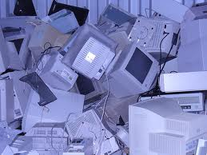



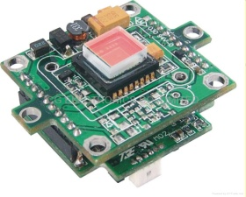


Raw Materials recycling from WEEE – ENEA approach
End of Life PCs
Manual dismantling, separation of components
Social jobs
Collection Centers
Batteries
Li, Co
Plastic componentis
materials, chemicals, syngas,
activated carbon
LCD
Flat screens
In, Sn, Y,
Eu, La, Ce,
Tb, Ga
Printed
Circuit Boards
Au, Ag, Sn, Cu,
Pb, Fe, Ta, Pd,
plastic
High
speakers
Nd, Pr
Hard disk
Nd, Pr, Dy,
Au, Pd, Pt,
Rh, Ru, Ta,
plastic
Product centric approach

Slide 14
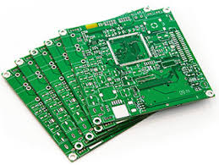


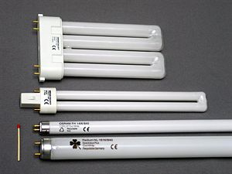
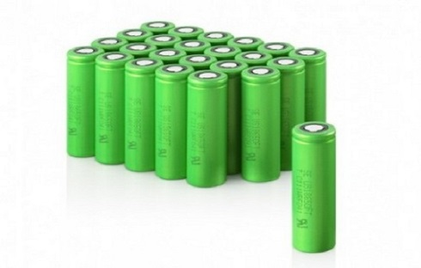
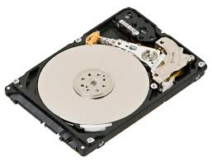
Raw Materials recycling from WEEE – ENEA technologies
Raw Materials recycling from PCBs
Patented process: RM2013A000549, PCT/IB2014/065131, EP nr 14798963.6
Prototype: RM2015A000064, PCT/IB2016/050763
Contact danilo.fontana@enea.it
Printed Circuit Boards
gold, silver, copper, tin, lead, palladium, plastics
Lithium batteries
lithium, iron
LCD flat screens
Photovoltaic panels
Fluorescent lamps
rare earths
Permanent magnets (Hard disk)
indium, tin
metal electrodes
Rare earths
antimonium, manganese
glass, silica
Raw Materials recycling from Photovoltaic panels
Thermal pre-treatment for PV components separation – under patent process
Contact: marco.tammaro@enea.it

Slide 15
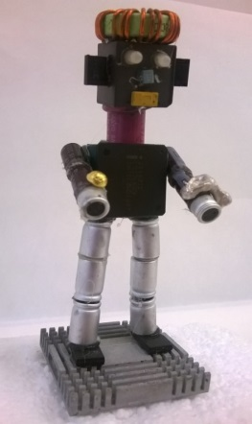
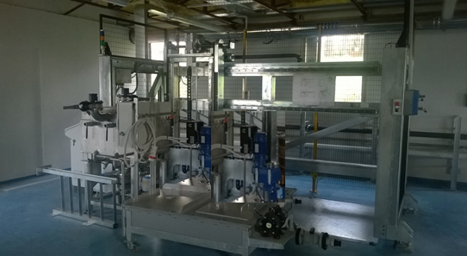
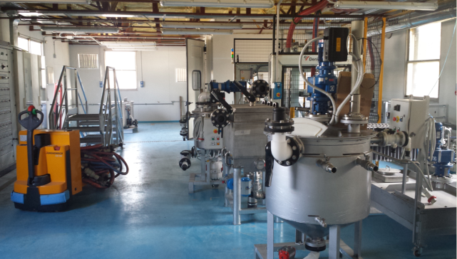
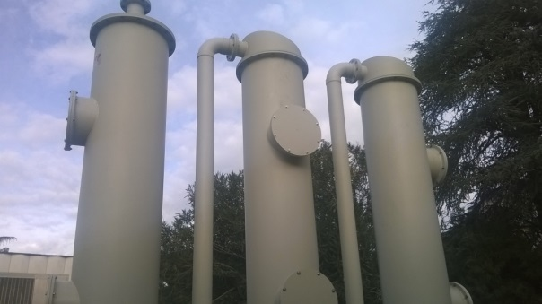
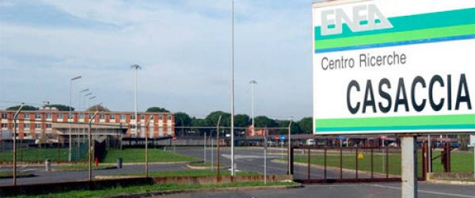
ROMEO pilot plant
Recovery Of MEtals by hydrOmetallurgy
Flexible and modular pre-industrial pilot plant designed for raw materials recycling from PCBs, can be adapted to the recycling from other end of life complex products and industrial scraps and byproducts.
Research Centre
CASACCIA
(Roma)

Slide 16
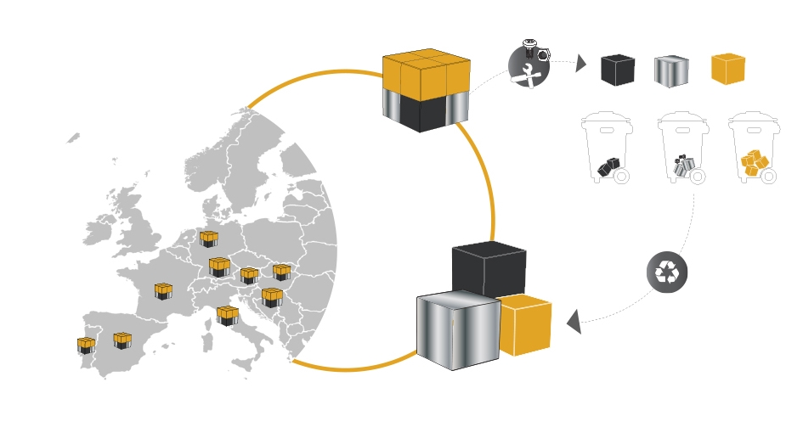


Network of Infrastructures - PCRec
Network of European organizations in the recycling sector dedicated to the product centric recycling of WEEE:
printed circuit boards
LCD flat screens
illumination devices
permanent magnets
Integrated recycling technologies and services on:
chracterization, pre-treatment, raw materials recycling and refining, sustainability evaluation, business plan

Slide 17
PCRec consortium - The knowledge triangle
University
University of Limerick
National Technical University of Athens
ENEA
VITO
CEA
Bay Zoltan
CNR
Relight
Centrum Kooperacji Recyklingu
CEINMATT
Votechnik
Inst. for non ferrous metal
Swedish Environ. Research Inst.
Mineral and Energy Economy Research Inst. of the Polish Academy of Sciences
Research
Industry

Slide 18

European Commission action plan for Circular Economy
Dialogue
Condivision
Best practice
ENEA was selected by the European Commission as member of the ECESP Coordination Group and, as unique Italian representative, it has been asked to act as a national hub, an interface between Italian Circular Economy Stakeholder and the European Platform, with the main objective to promote the sharing of best practices for circular economy implementation on the Italian territory.

Slide 19
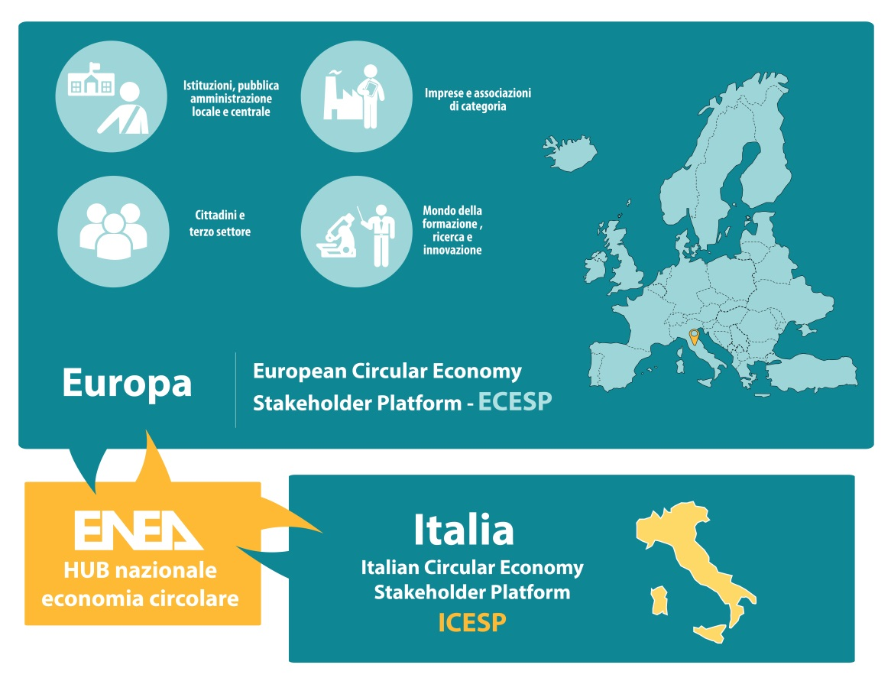
Italian Circular Economy Stakeholder Platform - ICESP

Slide 20
ICESP vs ECESP
ECESP tasks
  promote the dissemination of knowledge
  foster dialogue and identification of possible synergies
  map good circular economy practices
ICESP purposes
Carry on the European mandate to promote greater harmonization and integration between existing actions in Italy and in European countries:
promote the dissemination of knowledge;
foster dialogue and possible synergies between Italian stakeholders;
map Italian good practices.
encourage the integration of initiatives at the Italian level;
create a permanent operational tool that can promote and facilitate cross-sectoral dialogue and interactions;
spread Italian excellence and the Italian way of doing circular economy, starting from the traditions and typical issues of our country and the related cultural, social and entrepreneurial models: "The Italian way for circular economy"

Slide 21
ICESP - Organizzazione
Coordination (ENEA)
  Chair: Roberto Morabito
  ECESP interface: Laura Cutaia
  Technical coordination: Grazia Barberio
Working group | Coordinators
Research and innovation, knowledge diffusion and training/education | Università di Bologna Regione Puglia-ARTI CNA
Policy and Governance tools | MATTM–DG RIN MiSE Unicircular
Measurment tools | MATTM–DG SVI ENEA
Sustainable and circular systems for design, production, distribution and consumption | ENEL ENEA Intesa Sanpaolo Innovation Center
Cities and territory | ENEA ACT FONDAZIONE SVILUPPO SOSTENIBILE
Best practices and integrated approaches | Regione Puglia-ARTI Unioncamere, ENEA

Slide 22
ICESP – Interactions with ECESP
Working groups activities
(July-October 2018)
National Conference
(December 2018)
Euroepean Conference
(Febbruary 2019)
ICESP LAUNCH
31 May 2018
OUTPUT
INPUT
INPUT

Slide 23
CICERONE PROJECT - - Circular economy platform for European strategic research and innovation agenda
Project proposal under the call Horizon 2020 CE-SC5-05-2018: Coordinated approaches to funding and promotion of research and innovation for the circular economy.
Objective: elaboration of the European strategic agenda for research and Innovation funding for circular economy, allowing efficient use of funding resources avoiding duplicance for similar initiatives and overcoming their fragmentation through joint initiatives.
Stakeholder Circular
National POs
Regional POs
Innovation ecosystems, clusters, startups
Large Industry
Research
Civil Society / NGOs
Private investors
Municipal POs
SMEs
General Coordinator (programme owner): CLIMATE KIC
Technical Coordinator: ENEA
Technical partners: VITO (BE), TNO (NL), IETU (PL), WUPPERTAL (DE), IVL (SE), CEA (FR), VTT (FI)
Italian organizations participating in project consultation: Agenzia di Coesione Territoriale (Advisory Board ), Regioni Puglia, Regione Emilia Romagna, ENEL, HERA, INTESA SANPAOLO, UNICIRCULAR, CNA.

